Slide 1
Habitual goals
Adam Morris & Fiery Cushman

Slide 2
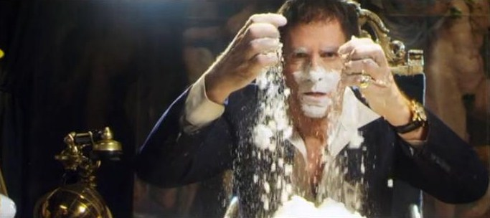
System 1
System 2
Fast, automatic
Slow, effortful
Associative
Rule-based
Habitual
Goal-directed
(Dolan & Dayan 2013)

Slide 3
Automatic goal activation
Goals can be activated automatically by context/stimuli (Huang & Bargh 2014)
Goals unconsciously associated with reward are more likely to be selected (Custers & Aarts 2005)
Those automatic goals recruit executive resources (Marien et al. 2012)

Slide 4
Roadmap
(1) Formalization
(2) Three behavioral experiments
(3) Discussion & applications

Slide 5
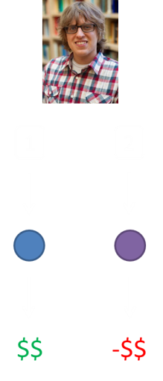
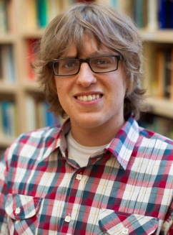
Reinforcement learning
1
good
2
bad
1
2
Model-based reinforcement learning
Model-free reinforcement learning
Goal-directed
Habitual
$$
-$$
(Sutton & Barto 1998)

Slide 6
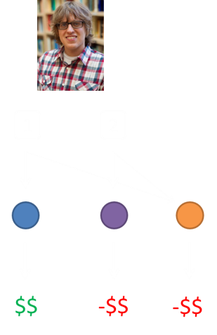
Distinguishing behavior
1
bad
Goal of
bad
1
2
$$
-$$
-$$
(Gläscher et al. 2010)

Slide 7
Our experiment
1
2
$$
-$$
-$$

Slide 8
Our experiment
1
2
3
4
$$
-$$
$$
-$$
-$$

Slide 9
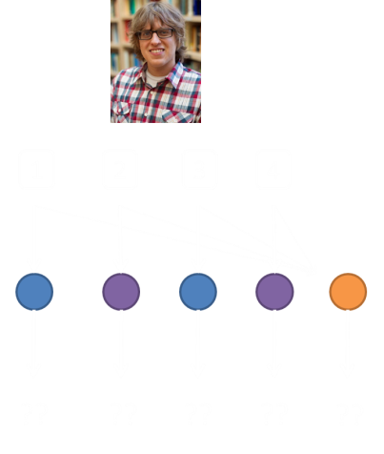
Our experiment
1
bad
Goal of
bad
1
2
3
4
??
??
??
??
-$$
??

Slide 10
Our experiment
1
bad
Goal of
bad
1
2
3
4
??
??
??
??
-$$

Slide 11
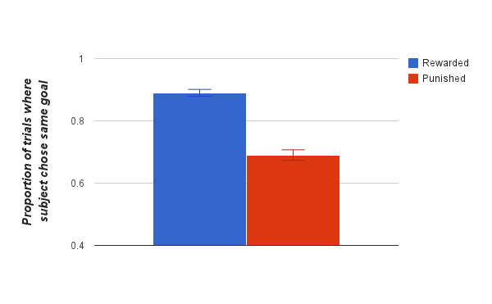
Our experiment
*
Orange’s value
Choice on next trial
β = .191, p < .0001
Controlled for MB and MF value of options 3, 4

Slide 12
Experiment #2
1
2
3
4
??
??
??
??
??

Slide 13
Experiment #2
A
B
C
D
1
2
3
4

Slide 14
Experiment #2
1
2
3
4
??
??
??
??
-$$
??

Slide 15
Experiment #2
A
B
C
D
1
2
3
4
Goal of
bad
??
??
??
??
-$$

Slide 16
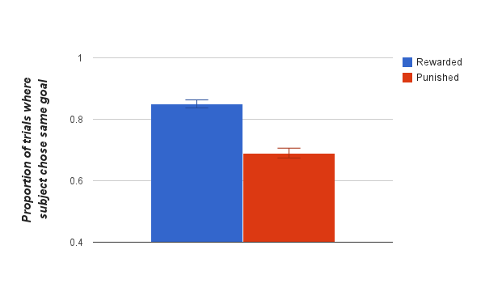
Experiment #2
*
Orange’s value
Choice on next trial
β = .143, p < .0001

Slide 17
Experiment #3
1
2
3
4
??
??
??
??
??

Slide 18
Experiment #3
Color trial
Congruent critical trials
Shape trial
Incongruent critical trials
1
2
3
4
??
??
??
??
-$$
??

Slide 19
Experiment #3
Color trial
Congruent critical trials
Shape trial
Incongruent critical trials
1
2
3
4
Goal of
bad
??
??
??
??
??

Slide 20
Experiment #3
Color trial
Congruent critical trials
Shape trial
Incongruent critical trials
1
2
3
4
??
??
??
??
-$$
??

Slide 21
Experiment #3
Color trial
Congruent critical trials
Shape trial
Incongruent critical trials
1
2
3
4
Goal of
bad
??
??
??
??
??
Prediction: We’ll only see the effect on congruent critical trials.

Slide 22
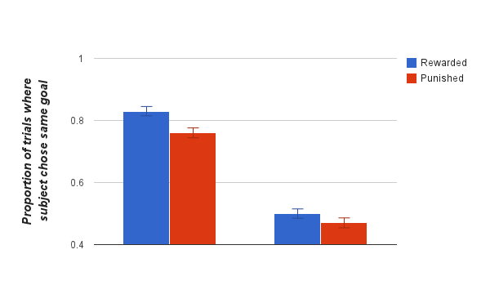
Experiment #3
*
ns
Congruent trials
Incongruent trials
Orange’s value * Type of critical trial
Choice on next trial
β = .049, p < .01

Slide 23
Roadmap
(1) Formalization
(2) 3 behavioral experiments
(3) Discussion & applications

Slide 24
What’s new here?
Dyna-2 (Silver et al. 2008)
Pavlovlian pruning of decision trees (Huys et al. 2012)
Model-free gating of working memory (O’Reilly & Frank 2004)

Slide 25
What does this help explain?
Automatic goal activation & reinforcement
Goals can be intrusive (Lhermitte 1983)
“Functional fixedness” (Adamson 1952)

Slide 26
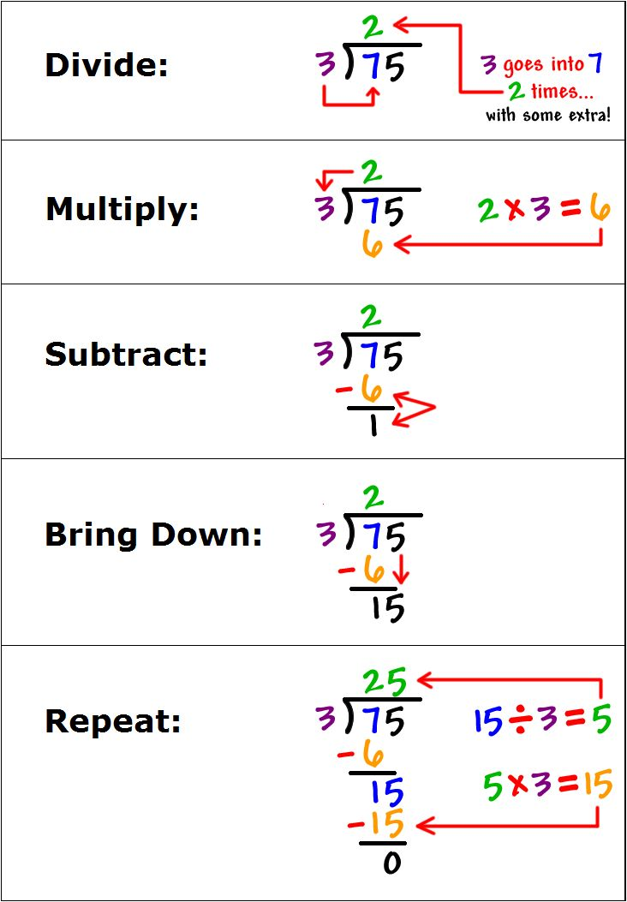
What does this help explain?

Slide 27
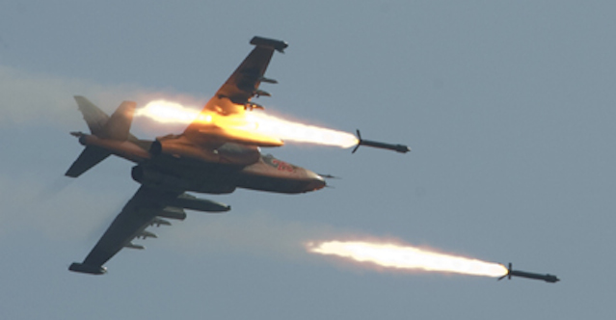
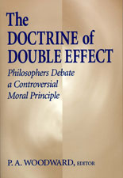
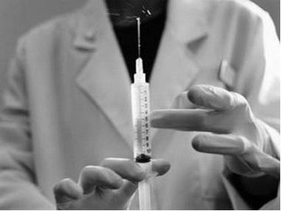
What does this help explain?

Slide 28
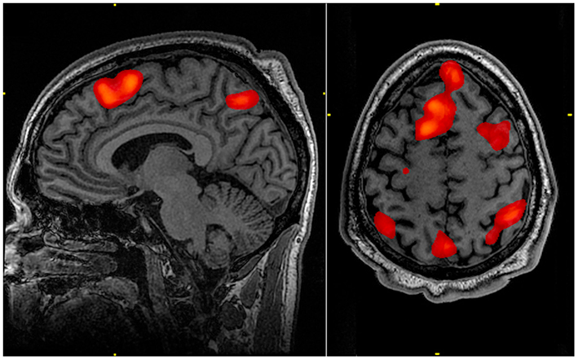

What’s next?

Slide 29
Ideas?

